Slide 1






AI-Driven Hybrid Cyber Defensive System for Intelligent Malware Detection and Threat Insight
Chimdessa Tesfaye
Getachewu Getu
Rediet Bekele
Meseret Gebreselasie
Date:16/06/2025

Slide 2

Outline
Concept note and implementation plan
Background
Objectives
SDG Relation
Data
Data Collection
Exploratory Data Analysis et Feature Engineering
Model
Model Selection and Training
Model Evaluation and Hyperparameter Tuning
Model Refinement and Testing
Results
Evaluation Results
Deployment
Future Work

Slide 3
Concept note and Implementation Plan

Slide 4

Background
Problem: Cyber threats are evolving rapidly, requiring smarter defenses.
Challenges:
Fragmented approaches: Reactive detection (signature-based) vs. proactive intelligence (manual analysis).
Resource-intensive and non-scalable methods.
Solution: Hybrid AI-driven system combining:
Malware detection (static binary analysis).
Threat intelligence (NLP-based text classification).

Slide 5
Objectives
Goal: Develop a hybrid AI-driven cybersecurity system to automate and enhance threat detection and intelligence.
Key Objectives:
1.Malware Detection:
Classify executables as malware/benign using PE header features.
2.Threat Intelligence:
Fine-tune BERT for binary classification (threat vs. non-threat).
Build two standalone tools (desktop and web) that offer real-time classification and analysis.
Impact: Reduce reliance on manual analysis. Improve scalability and response time against evolving threats.

Slide 6



SDG Relation
SDG 4 (Quality Education):
Promotes cybersecurity awareness and education.
This project aligns with these SDG goals:-
SDG 9 (Industry, Innovation & Infrastructure): Strengthens digital infrastructure security.
SDG 16 (Peace, Justice & Strong Institutions): Protects institutions from cybercrime.

Slide 7
SDG Relation
Real-World Impact and Scalability:
What makes this system practical and scalable is its ability to be deployed in both desktop and web environments-accessible by analysts, SOC teams, and even AI bots in the future.
Together, the Malware Detection engine and Threat Classifier provide layered defense detecting malicious code and understanding emerging threat trends from reports, emails, or alerts.
This project can help financial institutions, public services, and national cybersecurity centers make faster, smarter, and more proactive security decisions

Slide 8
Data

Slide 9


Data Collection
Malware Detection:
Dataset: 56,645 PE files (41,323 malware, 15,321 benign) from VirusShare.com.
Features: 54 PE header attributes (e.g., entropy, section sizes).
Threat Intelligence:
Dataset: 90+ articles from The Hacker News (scraped via RSS).
Fields: Title, summary, publication date, URL.

Slide 10
Exploratory Data Analysis and Feature Engineering
Malware Detection:
Data Cleaning: Removed redundant columns (e.g., file names), checked for missing values.
Feature Selection: Extra-Trees Classifier selected 13 critical features (e.g., SizeOfStackReserve, DllCharacteristics).
Threat Intelligence:
Text Preprocessing: Removed special characters, lowercased text, tokenized with BERT.
Labeling: Binary classification (threat-related vs. non-threat-related).

Slide 11
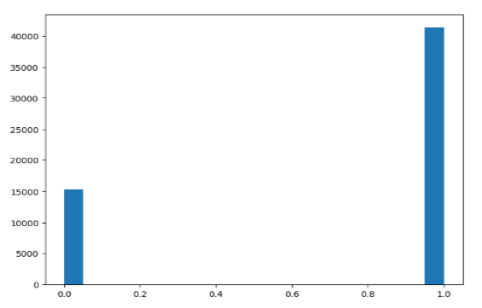
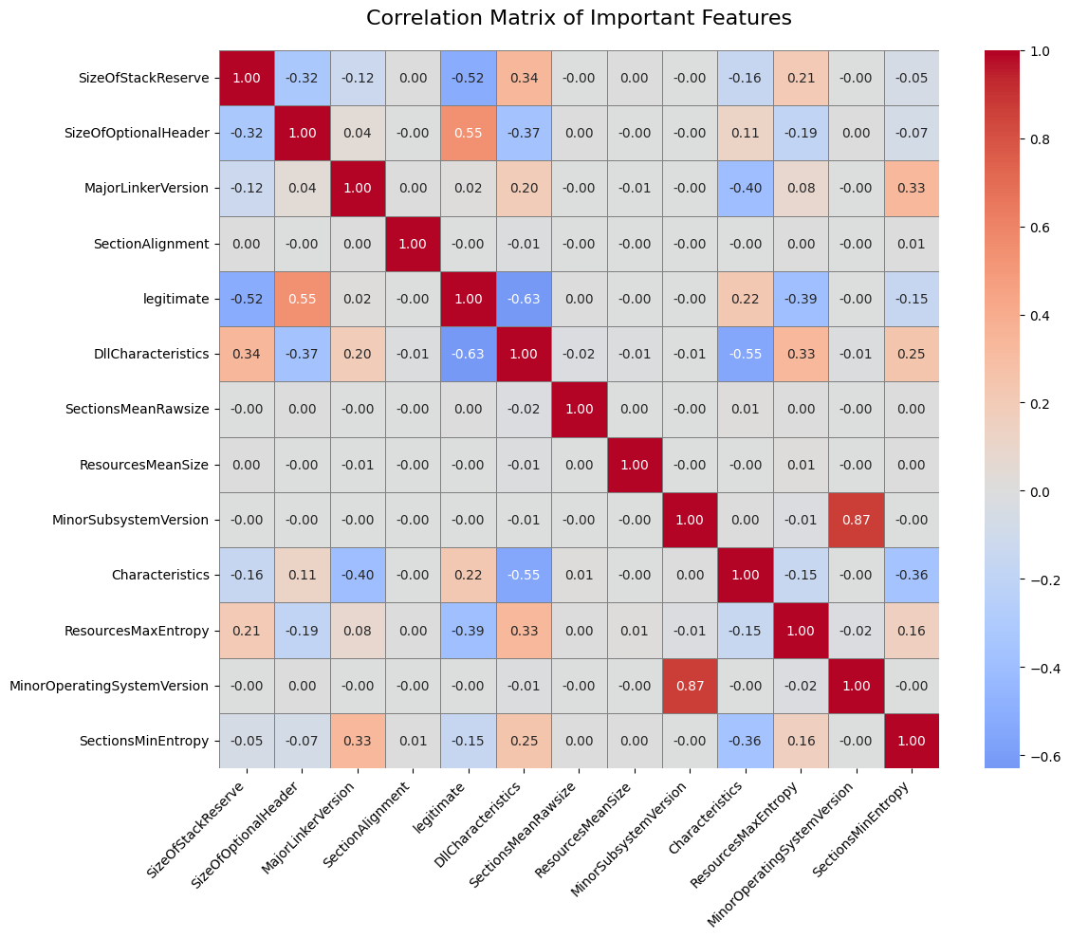
Exploratory Data Analysis and Feature Engineering
EDAs of malware dataset

Slide 12
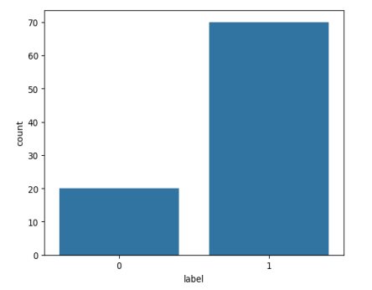
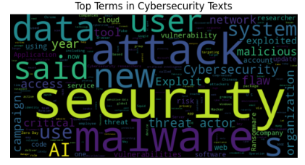
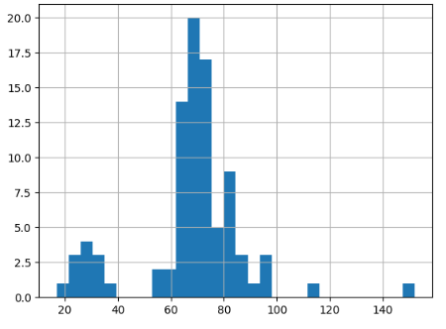
Exploratory Data Analysis and Feature Engineering
Text Length Distribution
Word cloud of the dataset
Class Distribution
EDAs of Threat Intelligence dataset

Slide 13
Model

Slide 14
Model Selection and Training
Selecting optimal algorithms and training them on preprocessed data.
Malware Detection:
Type: Classification models
Models: Logistic Regression, Random Forest, XGBoost, DNN, CNN, LSTM, Hybrid CNN-LSTM.
Training split: 80/20.
Target value: Legitimate column(1-malware & 0-benign)
Threat Intelligence:
Model: Fine-tuned BERT (bert-tiny-finetuned-sms-spam-detection).
Training: 10 epochs, 80/20 train/validation split.
Target Variable: Label(1-malware text or 0-Benign /safe text)
Goal: Identify best-performing base models

Slide 15
Model Evaluation and Hyperparameter Tuning
Quantifying performance and optimizing model parameters.
Malware Detection:
Metrics: Accuracy, F1-score, ROC,AUC.
Tuning: XGBoost(tree depth, learning rate)
Threat Intelligence:
Metrics: Accuracy, validation loss.
Tuning: BERT(epochs, batch size)
Goal: Maximize efficiency without overfitting

Slide 16
Model Refinement and Testing
Finalizing models for deployment through rigorous validation.
Malware Detection:
Pruning(XGBoost) and cross validation
Hybrid CNN-LSTM tested but retained XGBoost for efficiency.
Threat Intelligence:
Early stopping applied to prevent overfitting.

Slide 17
Results

Slide 18
Evaluation Results
Quantitative proof of model effectiveness.
Model used | F1 score on testing data | Accuracy score on testing dataset | Accuracy on training dataset | Training time (sec)
XGBoost | 99.11% | 99.52% | 99.88% | 1.03
RF | 99.05% | 98.62% | 98.44% | 5.39
LR | 96.03% | 94.45% | 94.32% | 3.24
DNN | 58.18% | 72.4% | 73.11% | 10.8
XGBoost achieved best accuracy-speed balance
Traditional ML outperformed DNN for this task
All models generalized well (train/test accuracy close)
Model used | Accuracy | Precision | Recall | F1 Score | ROC AUC | Loss | Training Time
CNN | 98.9% | 98.3% | 98.05% | 98.17% | 99.88% | 0.04 | 5.4
LSTM | 97% | 94.14% | 96.08% | 95.1% | 99.51% | 0.08 | 5.1
Hybrid CNN_LSTM | 98.98% | 98.26% | 98.37% | 98.32% | 99.88% | 0.03 | 5.3
Malware Detection

Slide 19
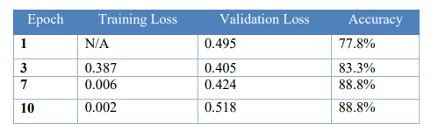
Evaluation Results
Fine-tuned BERT model.
Accuracy was the primary metric, with up to 88.8%.
accuracy after 10 epochs. Training loss reduced to 0.0023, while validation loss stabilized around 0.5.
While training loss continued to decrease, validation loss plateaued after epoch 7,
suggesting a good time to apply early stopping to prevent overfitting.
Threat intelligence classifier

Slide 20

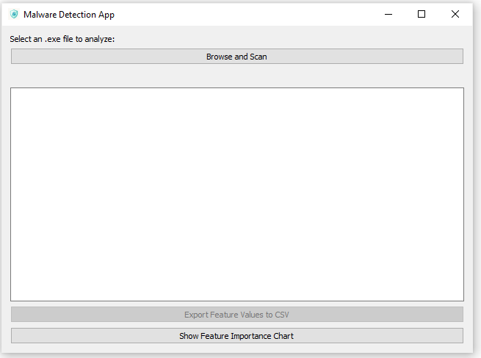
Deployment
Malware Detection App: PyQt5-based GUI with notification integration (plyer). Detects and alerts about executable malware (using saved xgboost.pkl model)
Threat Classifier App: Streamlit-based web interface for real-time classification of text-based cyber news (using saved bert classifier model)

Slide 21
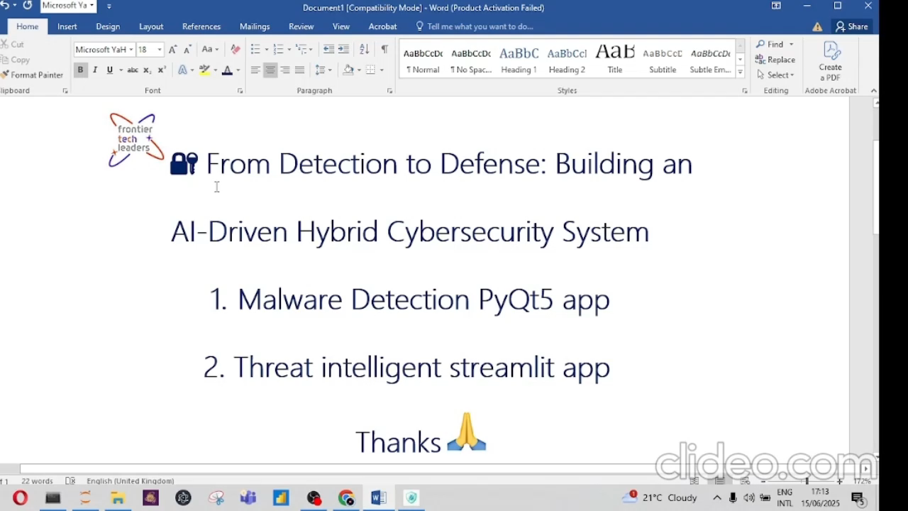
Deployment
Demo Video

Slide 22
Future Work
We plan to extend the system with:
Use real-time threat feed APIs (e.g., VirusTotal, MISP).
Extend threat classification to multi-class (APT, phishing, ransomware).
Expand NER to custom cyber tags using spaCy or Flair.

Slide 23
References
Tools: pefile, XGBoost, BERT, spaCy, Streamlit.
Datasets: VirusShare.com, The Hacker News.
Papers: Random Forests (Breiman 2001), XGBoost for malware detection (Pant 2022), SecureBERT (Aghaei 2022).

Slide 24


Thank you!
AI for Cyber Defence: Combining Static Detection with Dynamic Threat Understanding.

